Slide 1

On the Marketability of Neuromorphic Computing
David Song
‹#›

Slide 2
Overview
Defining commonly used terms
Innovator’s Dilemma
The coupled origins of neuromorphic computing & AI
State of the computing industry
Current neuromorphic computing technology
Future of neuromorphic computing
Questions
‹#›

Slide 3
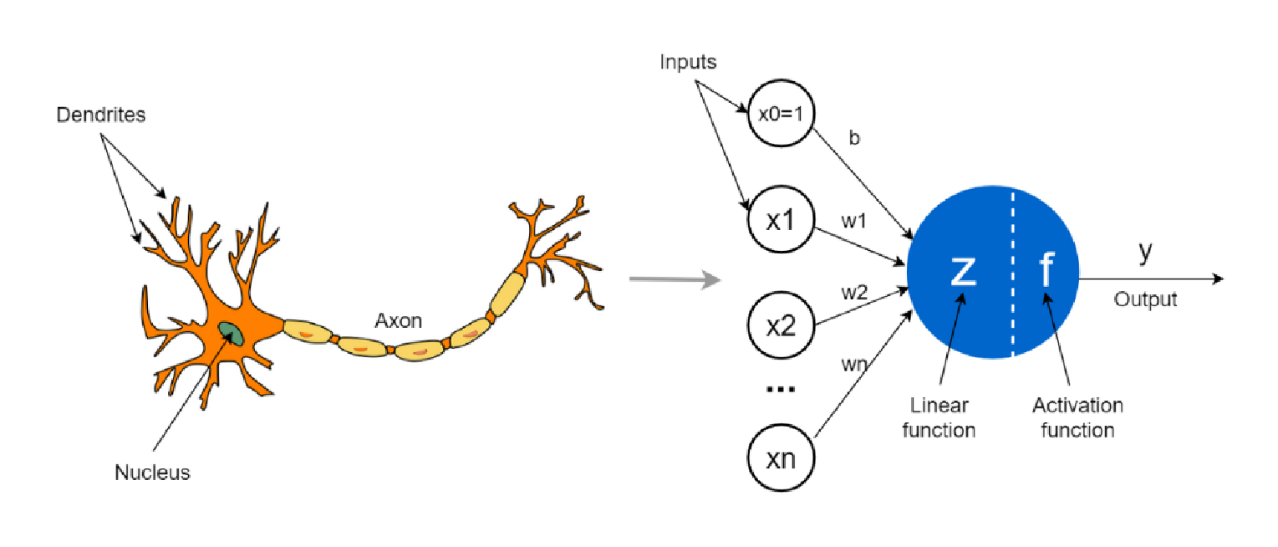
Defining Terms
Conventional Computing - von Neumann
Neuromorphic Computing – computing architecture that uses biomimicry of a biological brain structure.
Artificial Neural Networks – commonly shortened to ‘Neural Networks’
A collection/sets of artificial neurons to model the neurons in a biological brain

Slide 4
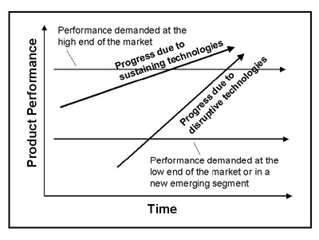
Innovator’s Dilemma
Sustaining technology
Disruptive technology
Large companies have to choose whether or not to invest in disruptive technology
Opportunity for startups to catch larger companies by surprise
‹#›

Slide 5

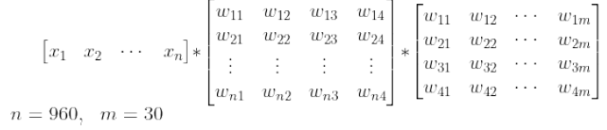
The coupled origins of Neuromorphic Computing & AI
(1958) Perceptron – First modern ANN
(’60s – ’80s) First AI Winter – Minsky and Papert
(1986) Autonomous Land Vehicle In a Neural Network
Real-world application for NN
Hidden Layers & Backpropagation

Slide 6
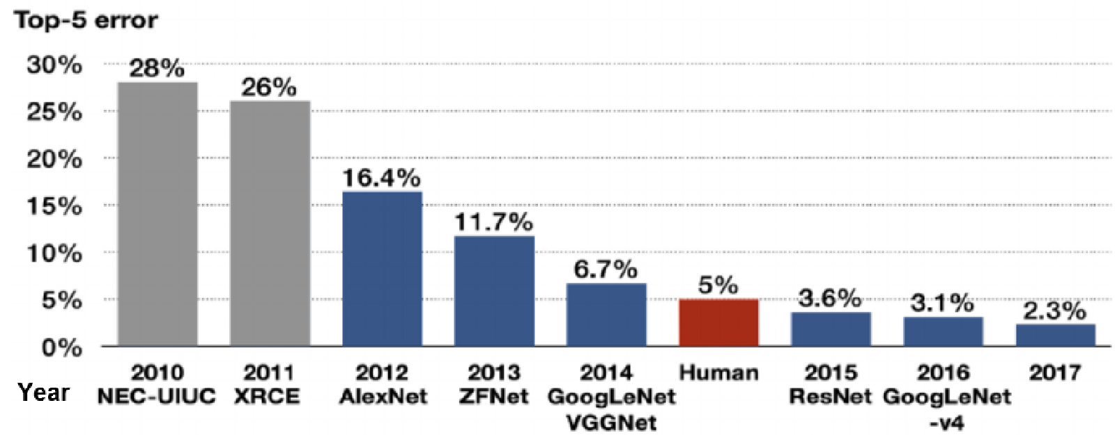
The coupled origins of Neuromorphic Computing & AI
(2006) ImageNet – Deepening NN
Problem in training volume, not hardware or software implementation of NN
(2012) AlexNet wins ImageNet Large Scale Visual Recognition Challenge by pioneering usage of GPU

Slide 7
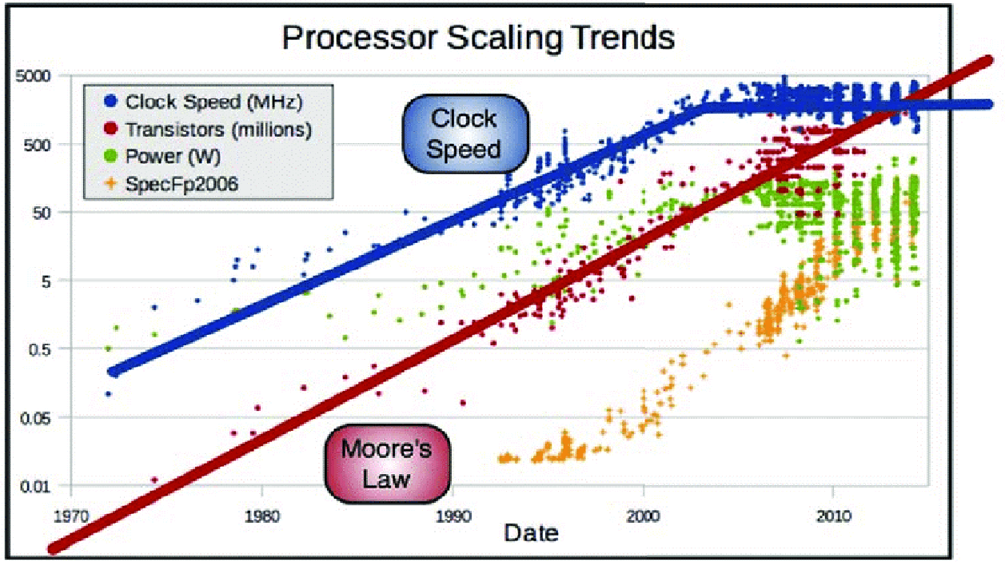
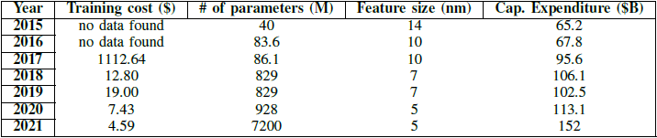
State of the computing industry

Slide 8
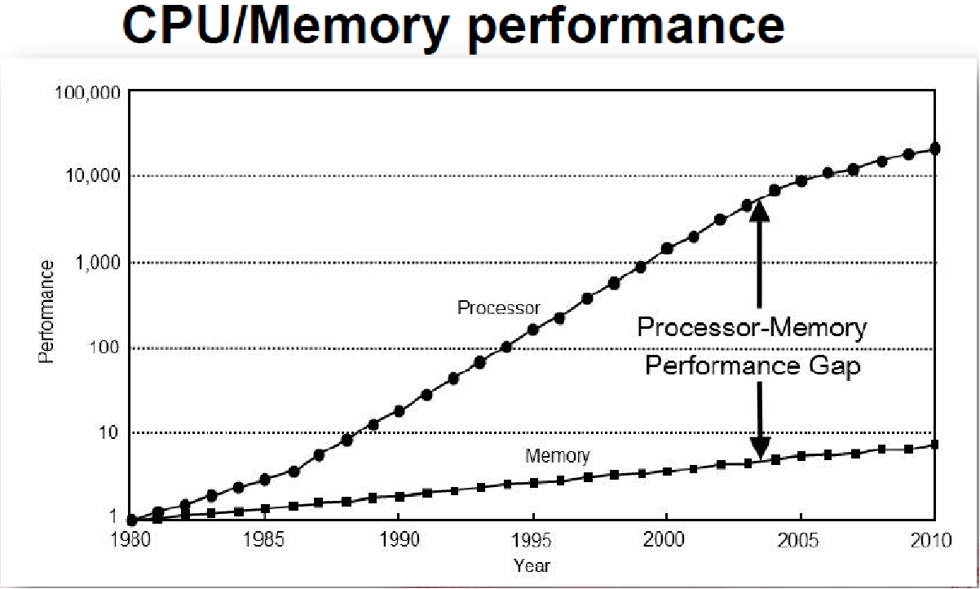
State of the computing industry

Slide 9
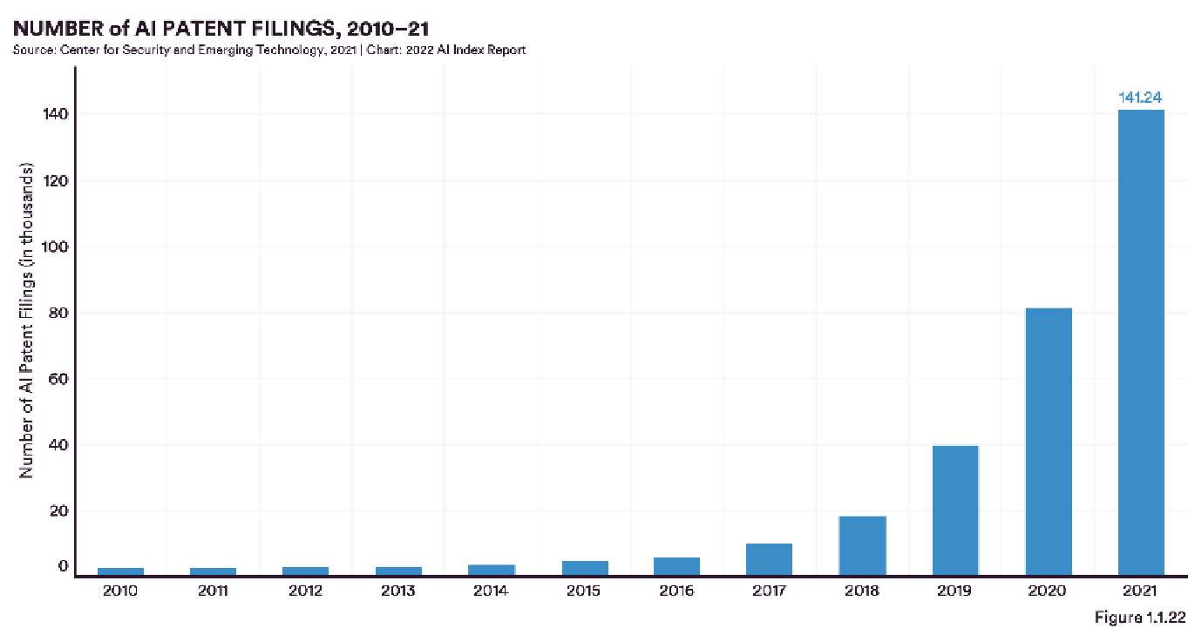
State of the computing industry

Slide 10
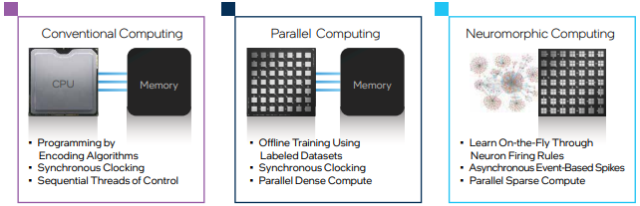
Current State of Neuromorphic Computing
Intel – leading the neuromorphic charge
Loihi
1M neurons in chip
Consumes < 1W vs. 10’s-100’s W for CPU & GPU
Does not require operation in cold temp unlike conventional computing

Slide 11
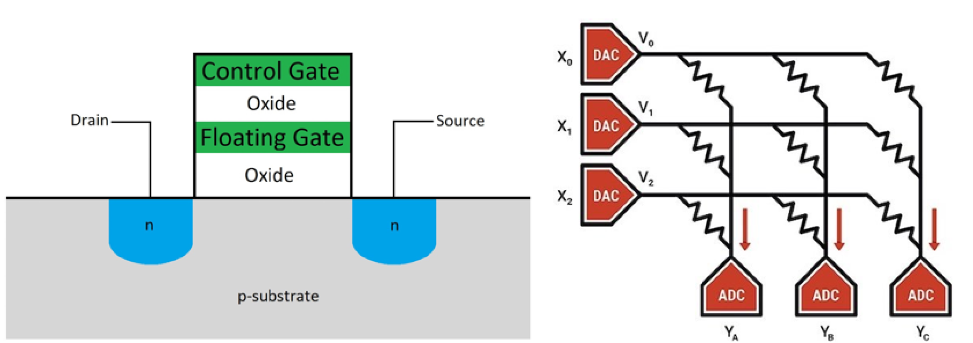
Current State of Neuromorphic Computing
Mythic AI (Disruptor)
M1706 Analog Matrix Processor
First analog AI chip using in-memory analog computation
Uses flash storage cell as variable resistor rather than a switch
35 TOPS with 3W power profile

Slide 12
Future of Neuromorphic Computing
Lack of performance gap between neuromorphic and conventional computing
Diversify training methods from backpropagation (on-chip)
Lack of benchmarking and standard performance metrics
Develop suite of benchmark programs including AI/non-AI use cases
Dependence on Digital signals for signal stability
???
Continue to promote new values for computing where neuromorphic computing can outperform conventional computing

Slide 13

‹#›

